Slide 1
“Analytical” Occupations
Brady Duncan

Slide 2
AGENDA
Approach
“Analytical” Definition
Insights
Review

Slide 3
Approach
Occupation Data – Job Descriptions
“Analytical” Keywords

Slide 4
Approach
Terms
Method
data
statistical
quantitative
predictive
business intelligence
problem-solving
attention to detail
project management
domain knowledge
continuous learning
analytical
decision-making
pattern recognition
modeling
metrics
insights
correlation
causation
insight
validation
experimentation
causality
forecasting
summary
recommendation
comparison
Preprocessing
stem, remove stopwords, lowercase
both key terms and descriptions
Filtering
Analysis
Repetition

Slide 5
Analytical Definition
Effectively describing the data in a concise and digestible manner
DATA
Viewing, manipulating, and sharing domain-specific data
ANALYSIS
Analyzing specific behaviors, patterns, and their effects
LEARNING
Gaining knowledge from data
Using knowledge gained to make conclusions or suggestions
SUMMARY
INSIGHTS

Slide 6
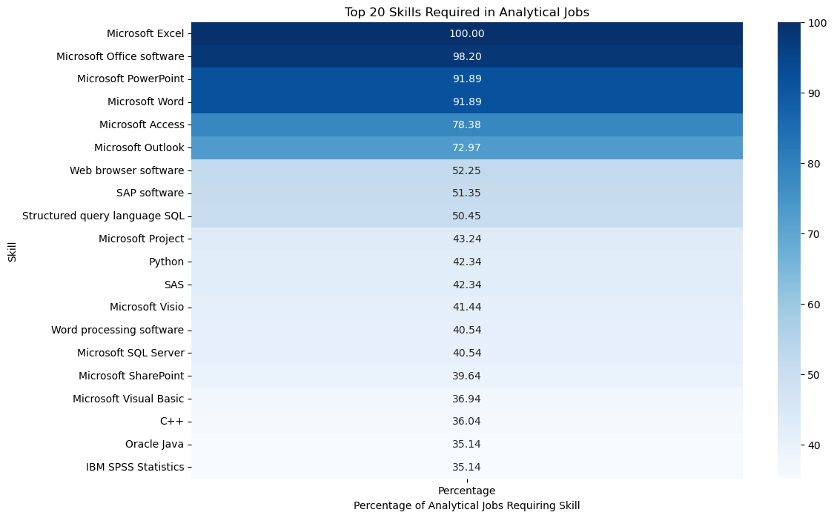
Insights
TECHNICAL SKILLS
Microsoft Office dominates
SQL tops programming languages
Python, SAS closely follow
Heavy percentage drop-off after MS

Slide 7
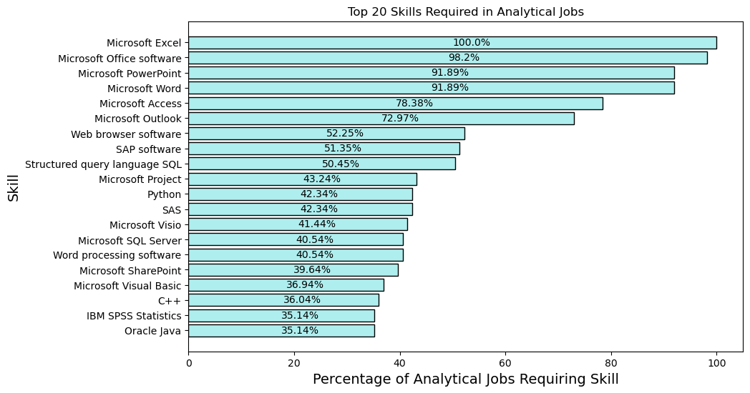
Insights

Slide 8
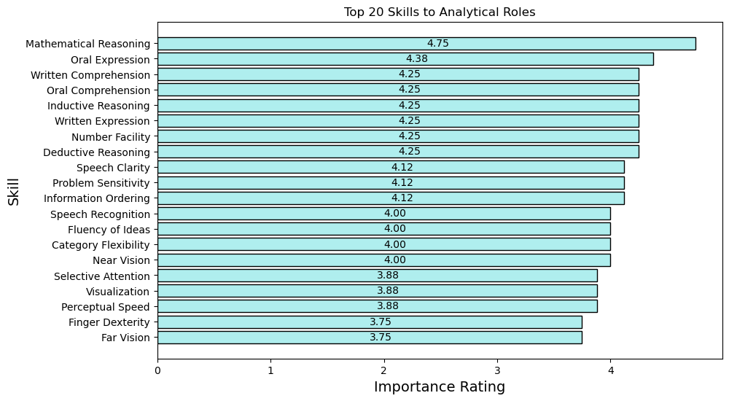
Insights
GENERAL SKILLS
Mathematical Reasoning
Written & Oral skills crucial
Reasoning & Problem Solving

Slide 9
Insights
CONCLUSIONS
Microsoft Office products should be top priority
Intangible skills such as analytical thinking, reasoning are essential
Various ways to qualify for roles
QUESTIONS
Rising popularity of Artificial Intelligence
Relevance of specific skills

Slide 10
Review
STRENGTHS
IMPROVEMENTS
PROJECT REFLECTION
​Visualizations
Both types of skills
Results easily understood
Stronger approach
​​​Classification model
Multiple databases/sources
Example analytical jobs for training data
Option for various strategies is fantastic

Slide 11
THANK YOU
Brady Duncan
duncan.br@northeastern.edu

